Slide 1
INK4 : CDK6 : cyclinD | PROTAC | E3 ligase adapter
PDB ID: 1G3N | BSJ-03-123 | CRBN
 | BSJ-03-189 | CRBN
 | BSJ-05-017 | VHL
BSJ-03-123
(CRBN CDK6-specific)
BSJ-03-189
(CRBN CDK4/6-dual)
thalidomide
thalidomide
BSJ-05-017
(VHL CDK4/6-dual)
palbociclib

Slide 2
BSJ-03-123
(CRBN CDK6-specific)
BSJ-03-189
(CRBN CDK4/6-dual)
thalidomide
thalidomide
palbociclib
canonical SMILEs:
BSJ-03-123
CC1=C(C(=O)N(C2=NC(=NC=C12)NC3=NC=C(C=C3)N4CCN(CC4)CCOCCOCCOCCNC(=O)COC5=CC=CC6=C5C(=O)N(C6=O)C7CCC(=O)NC7=O)C8CCCC8)C(=O)C
BSJ-03-189
CC1=C(C(=O)N(C2=NC(=NC=C12)NC3=NC=C(C=C3)N4CCN(CC4)CCNC(=O)COC5=CC=CC6=C5C(=O)N(C6=O)C7CCC(=O)NC7=O)C8CCCC8)C(=O)C

Slide 3
BSJ-05-017
(VHL CDK4/6-dual)
C[C@@H](C1=CC=C(C2=C(N=CS2)C)C=C1)NC([C@@H]3C[C@H](CN3C([C@H](C(C)(C)C)NC(CCCCN4CCN(C5=CC=C(N=C5)NC6=NC=C7C(C)=C(C(N(C7=N6)C8CCCC8)=O)C(C)=O)CC4)=O)=O)O)=O

Slide 4
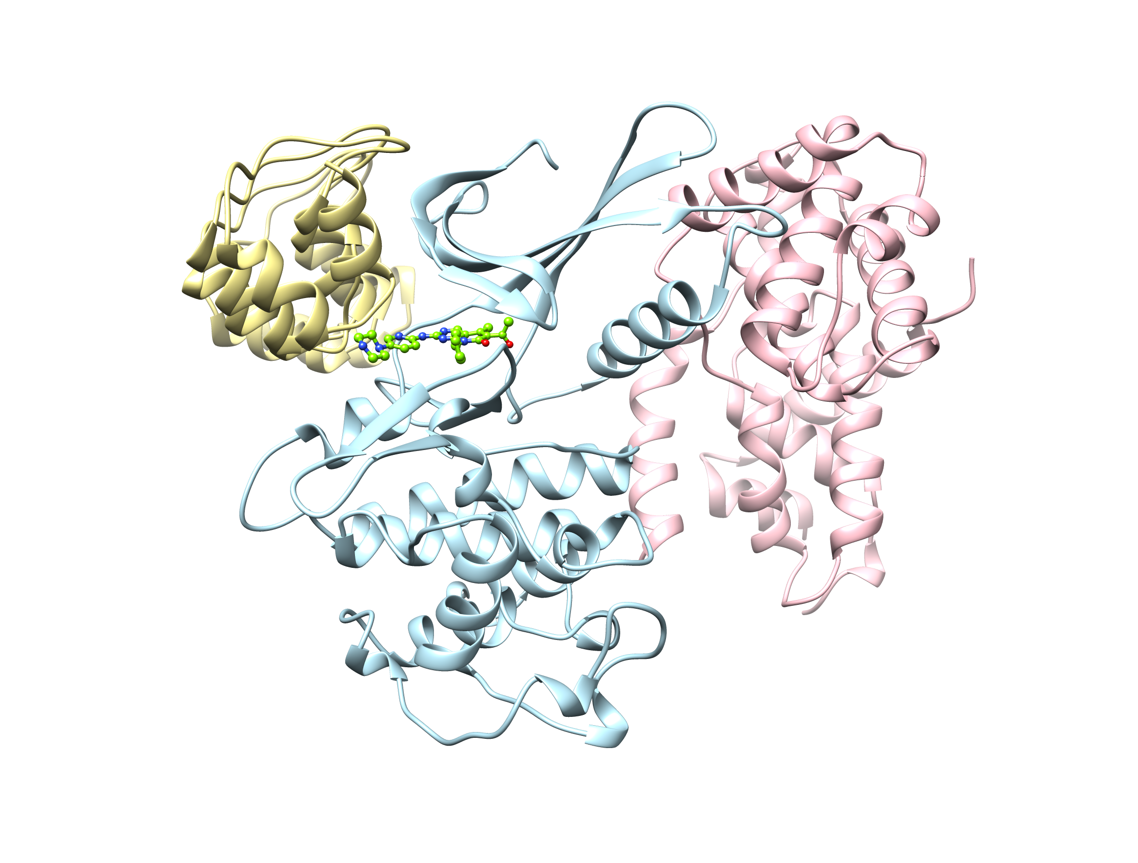
INK4 : CDK6 : palbociclib : cyclinD complex

Slide 5
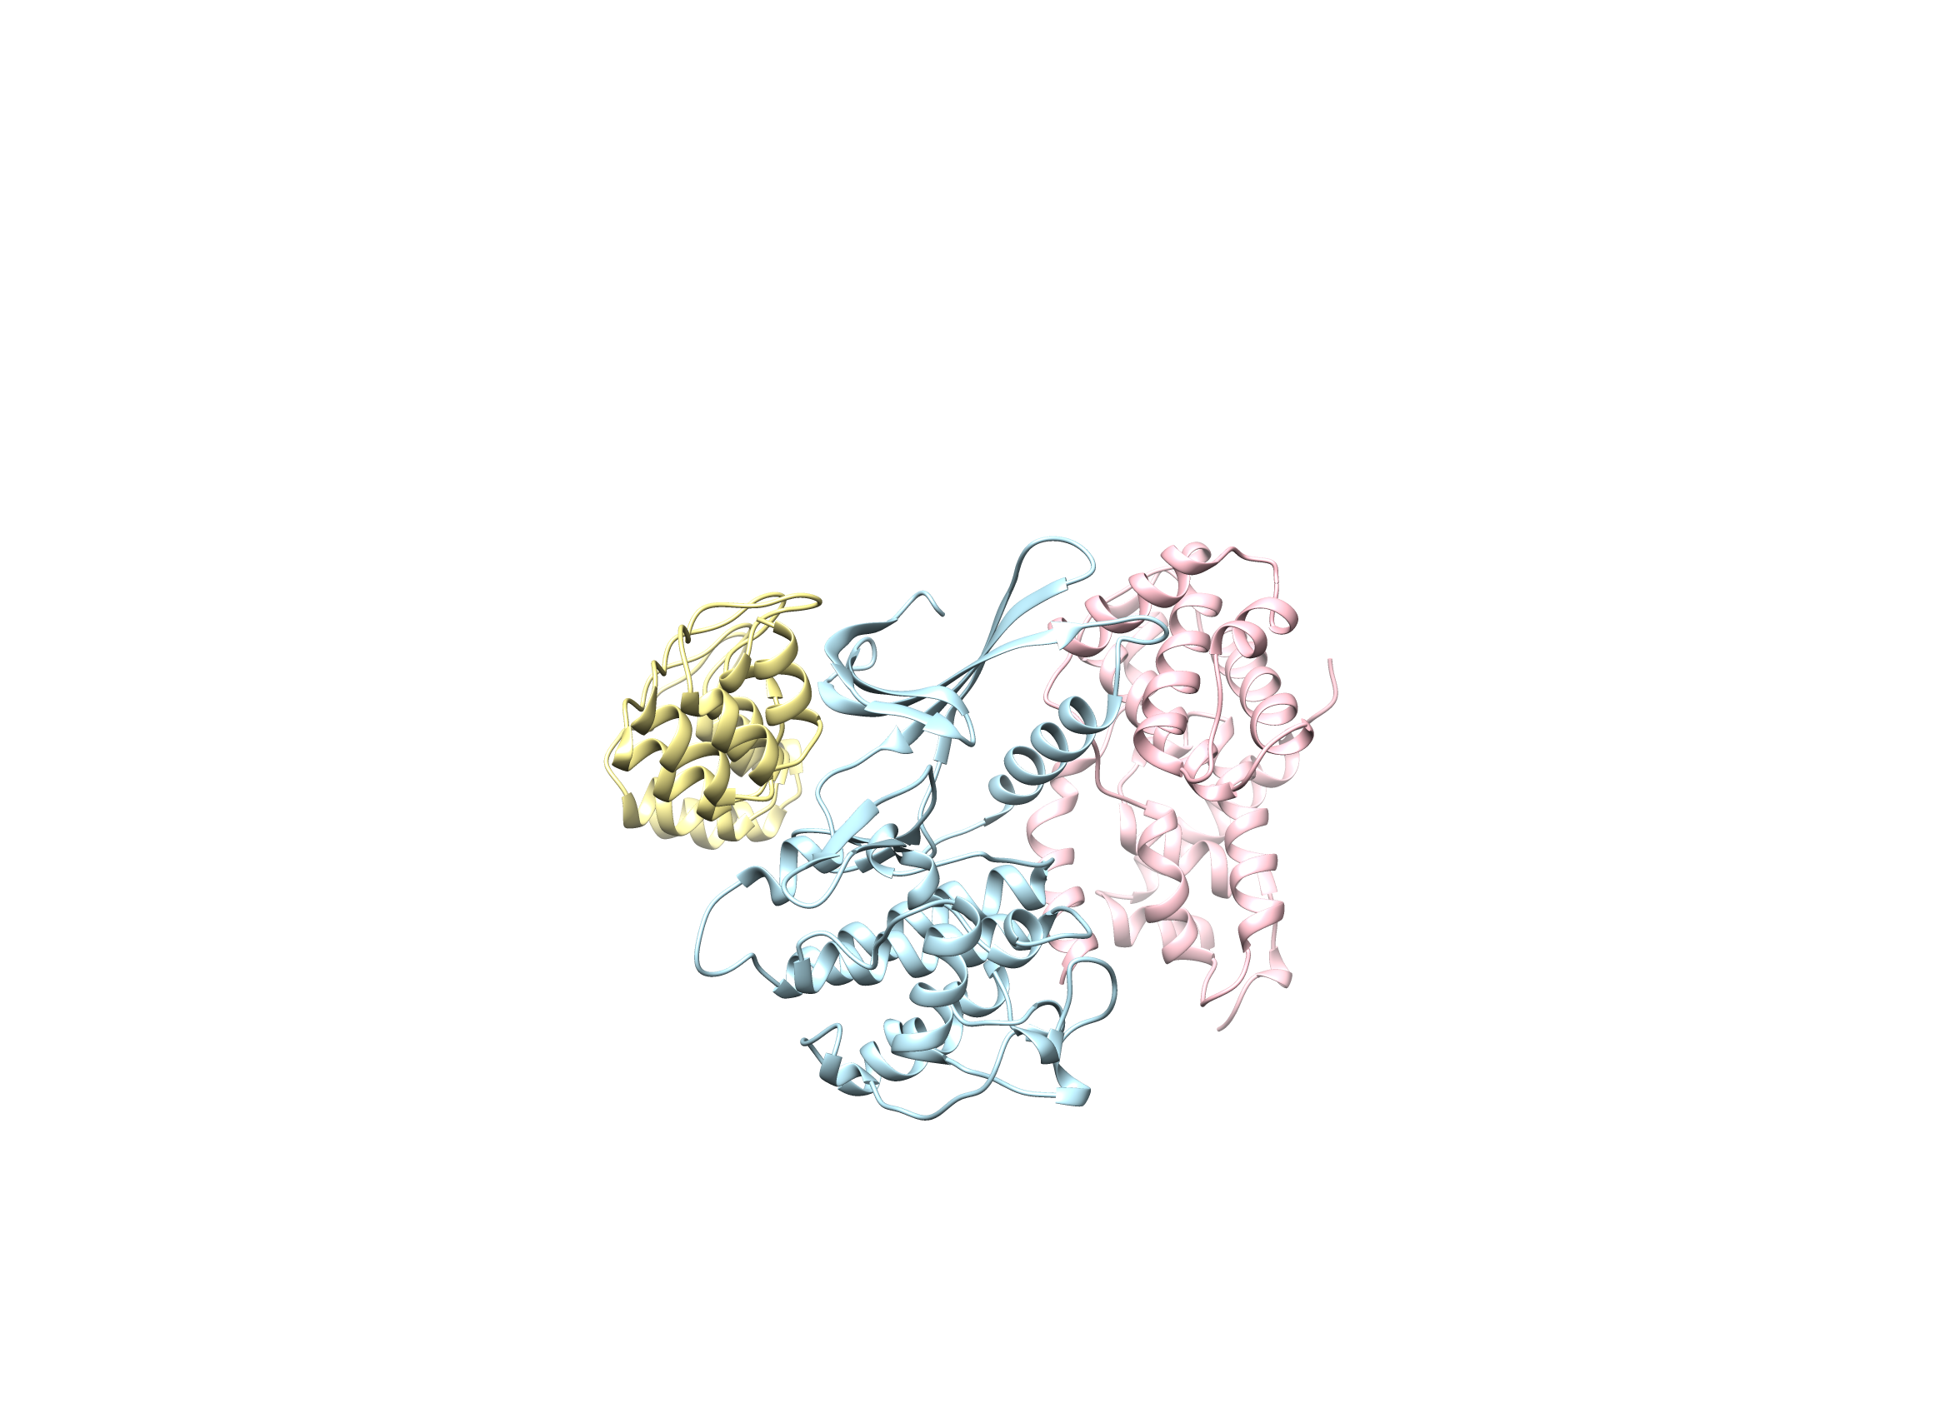
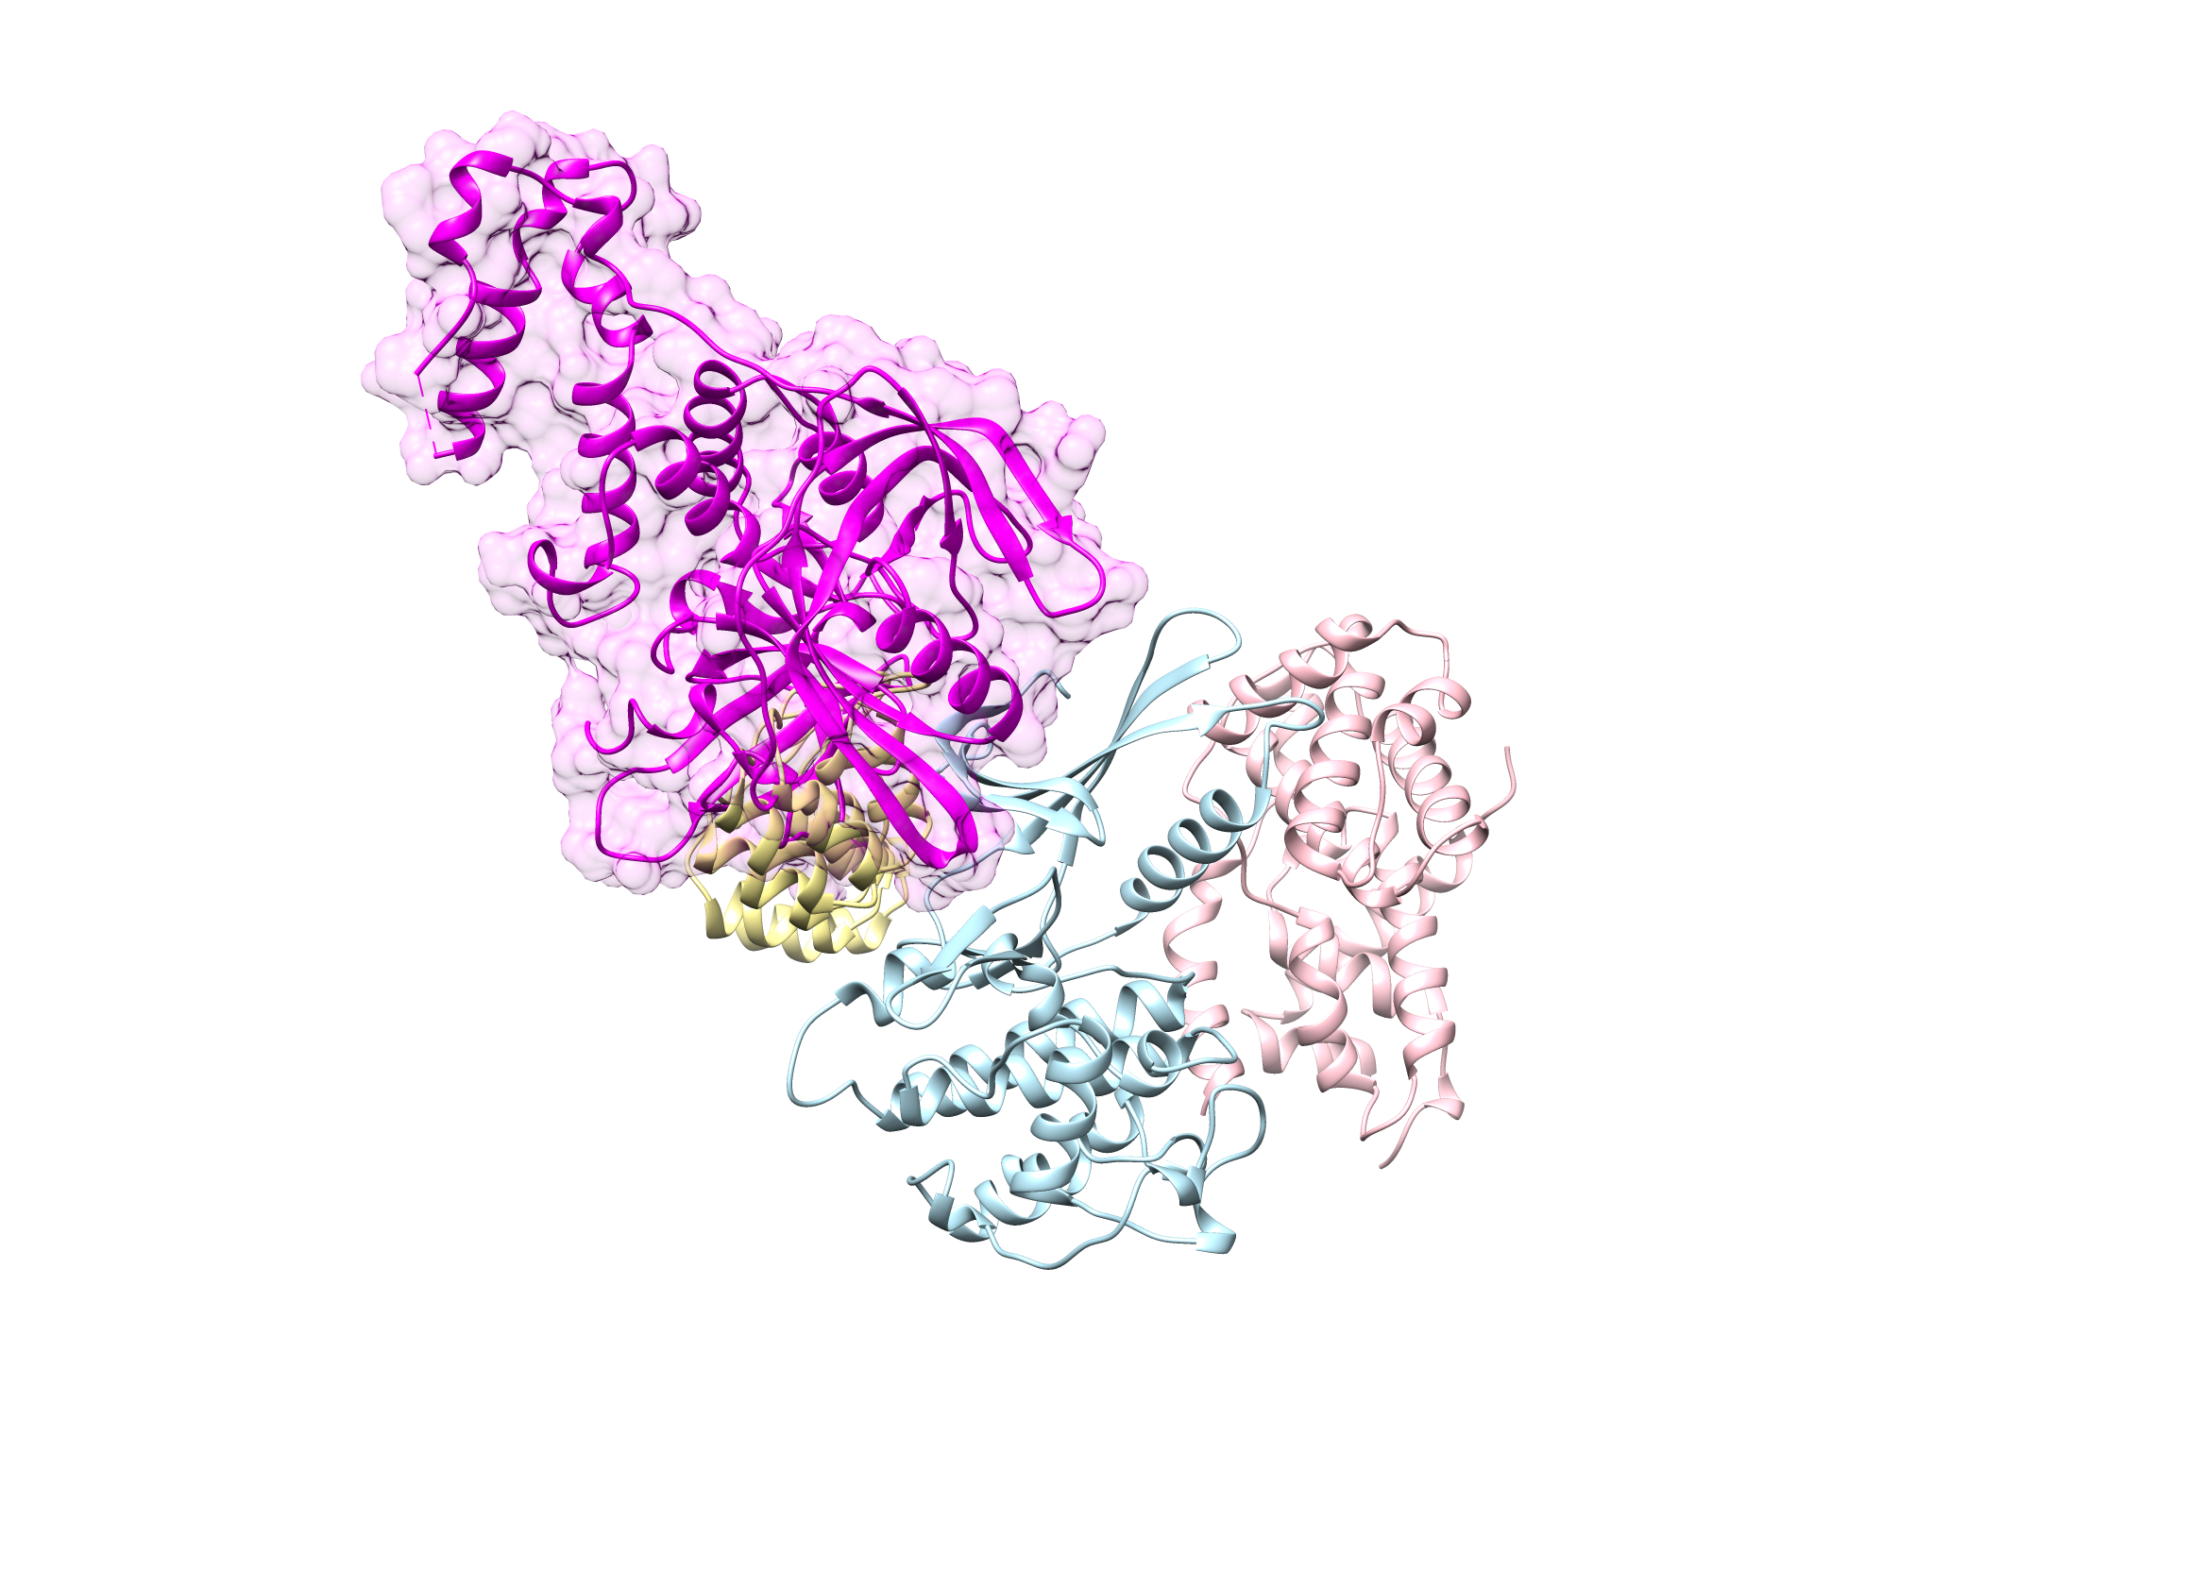
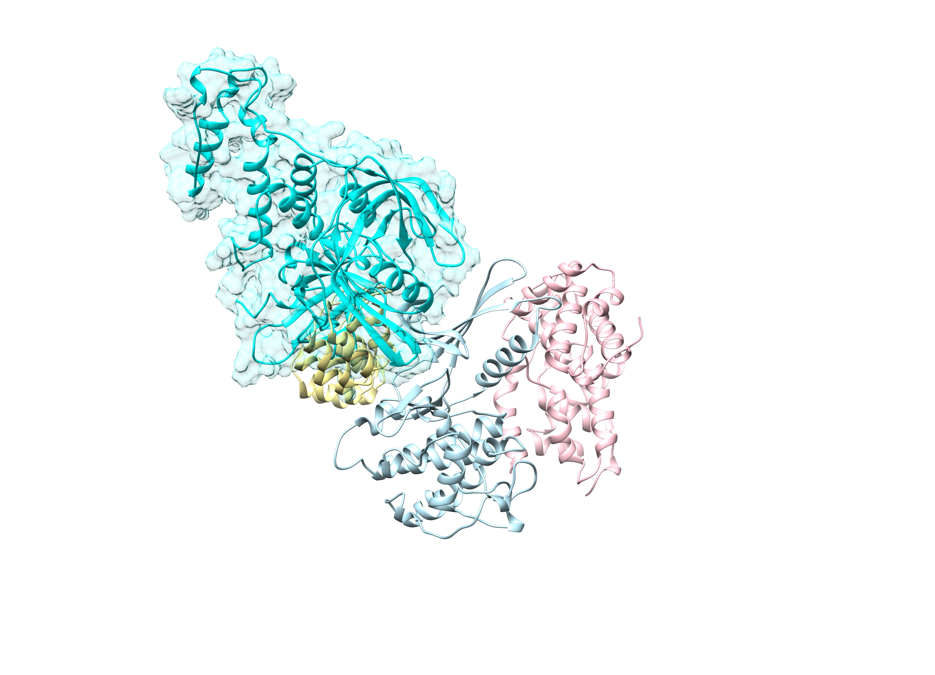
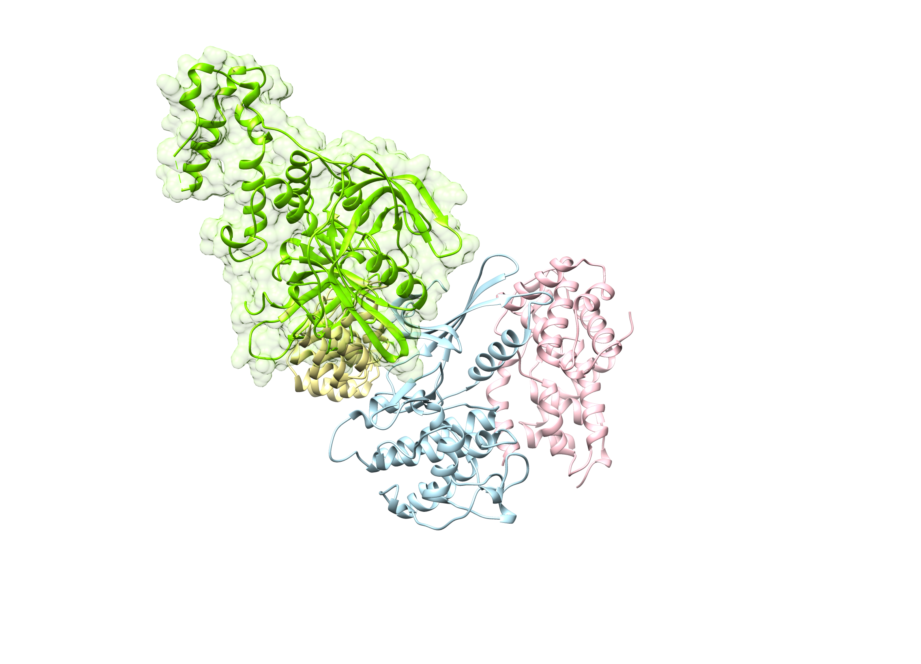
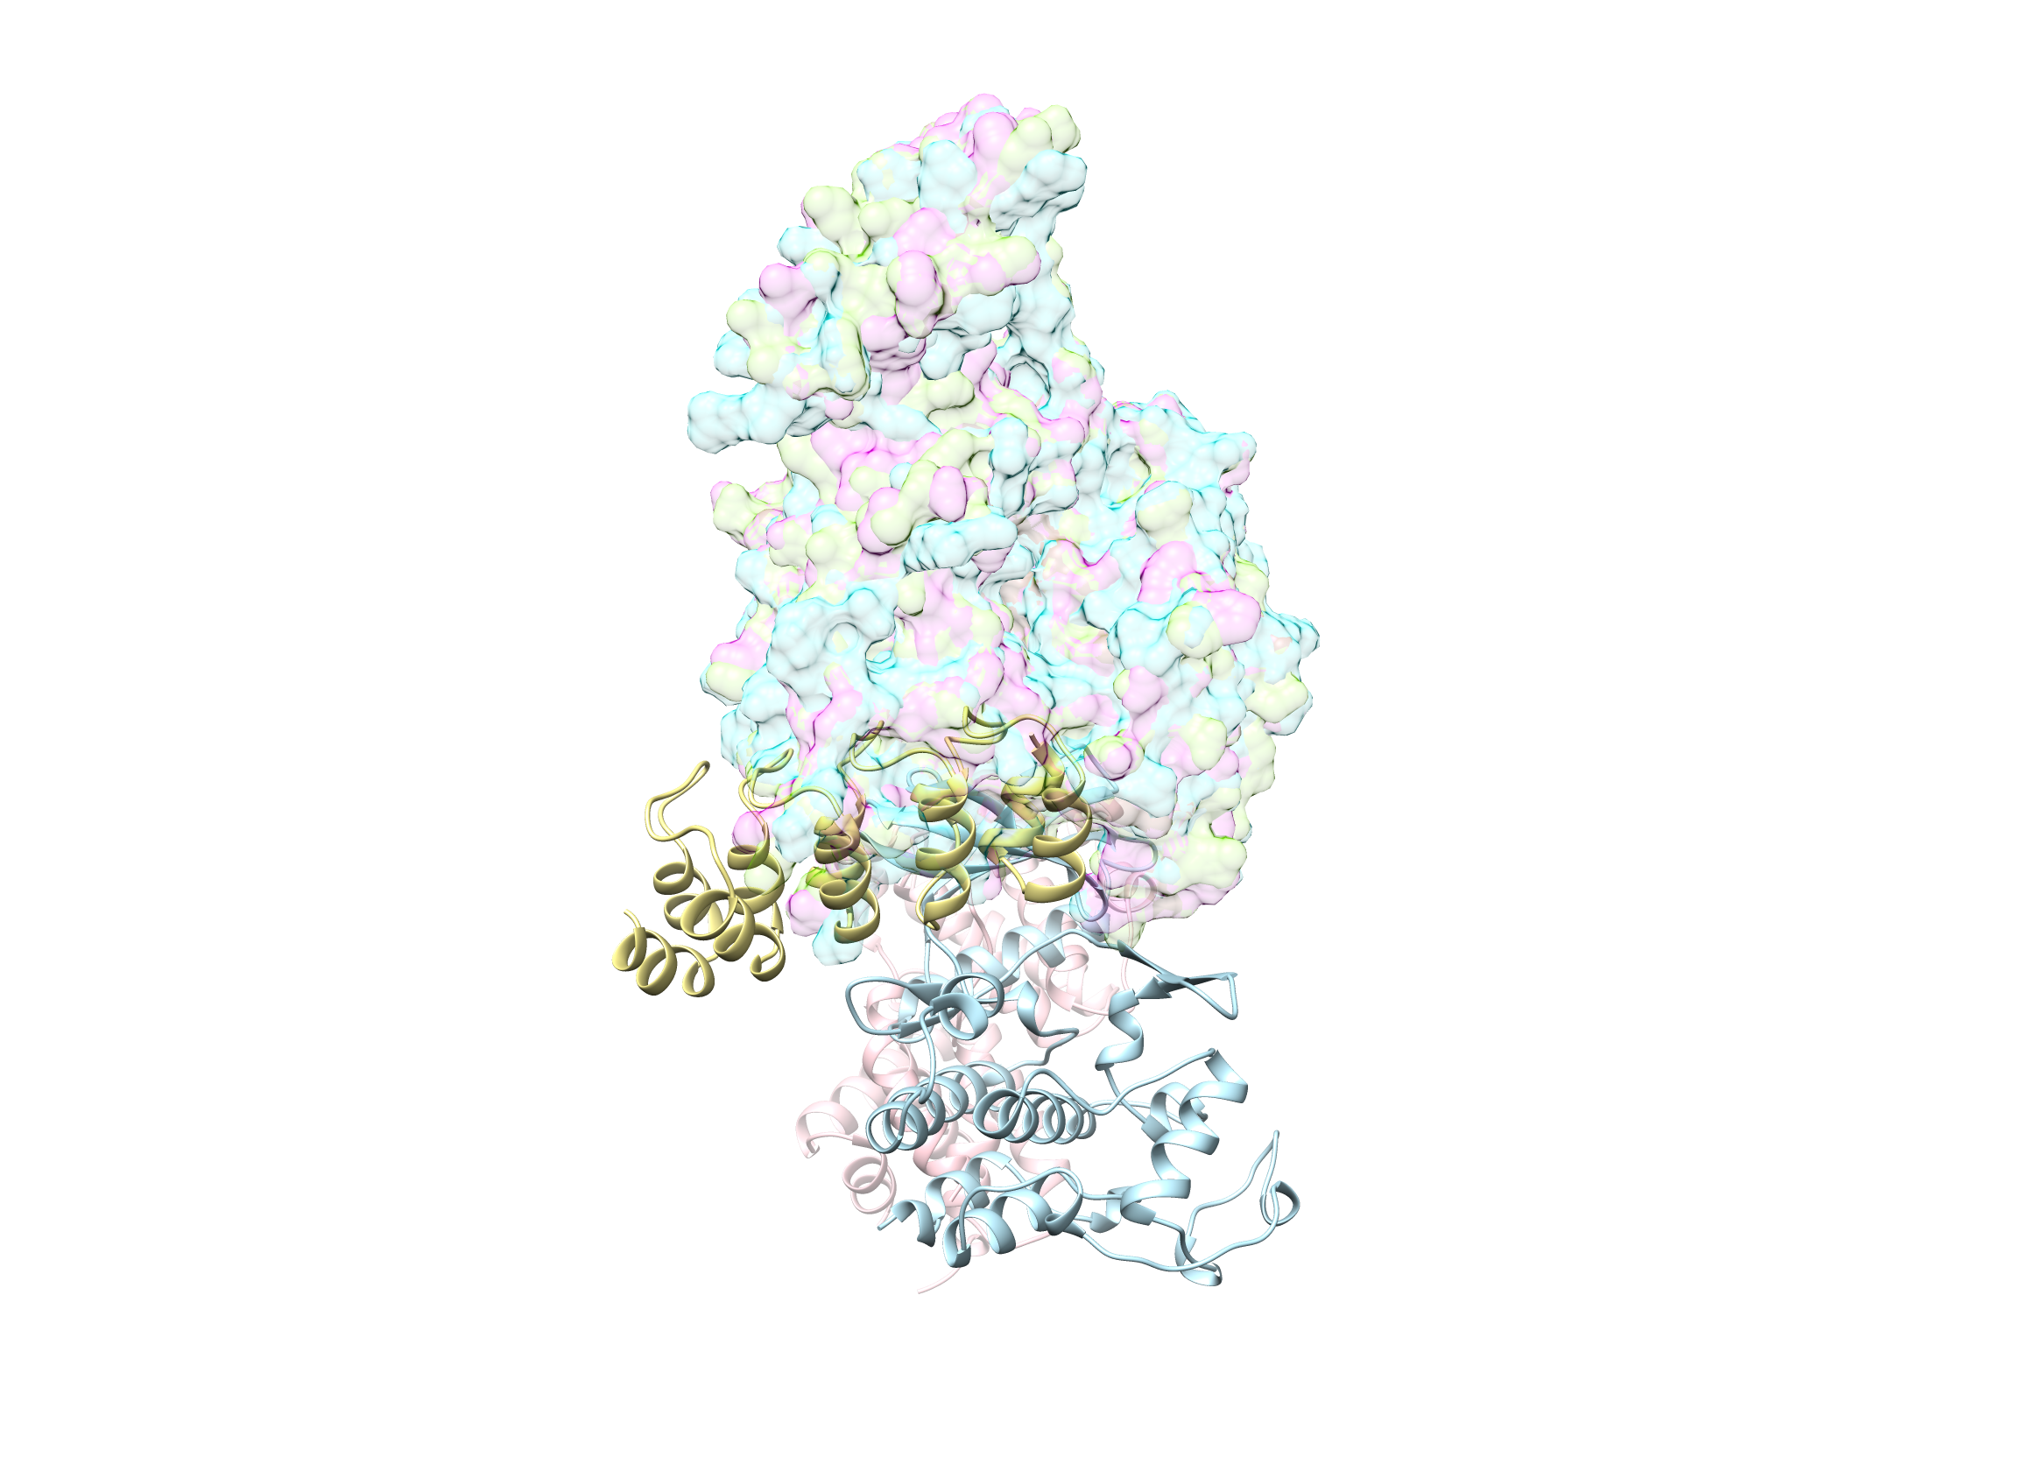
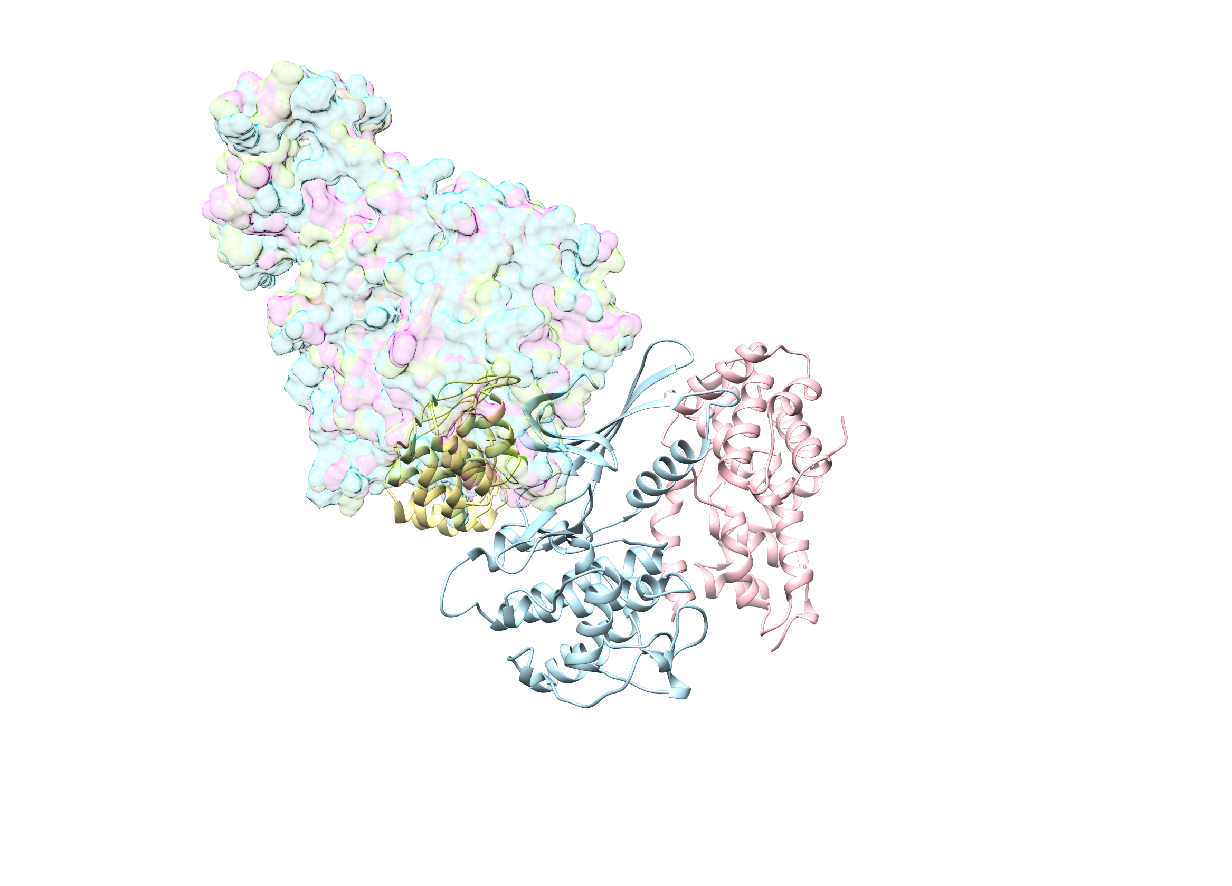
INK4 : CDK6 : CyclinD
(PDB ID: 1G3N)
CK1 : CRBN
(PDB ID: 5FQD)
BTK : CRBN
(London lab)
CDK6 : CRBN
(collaborator)
90°

Slide 6
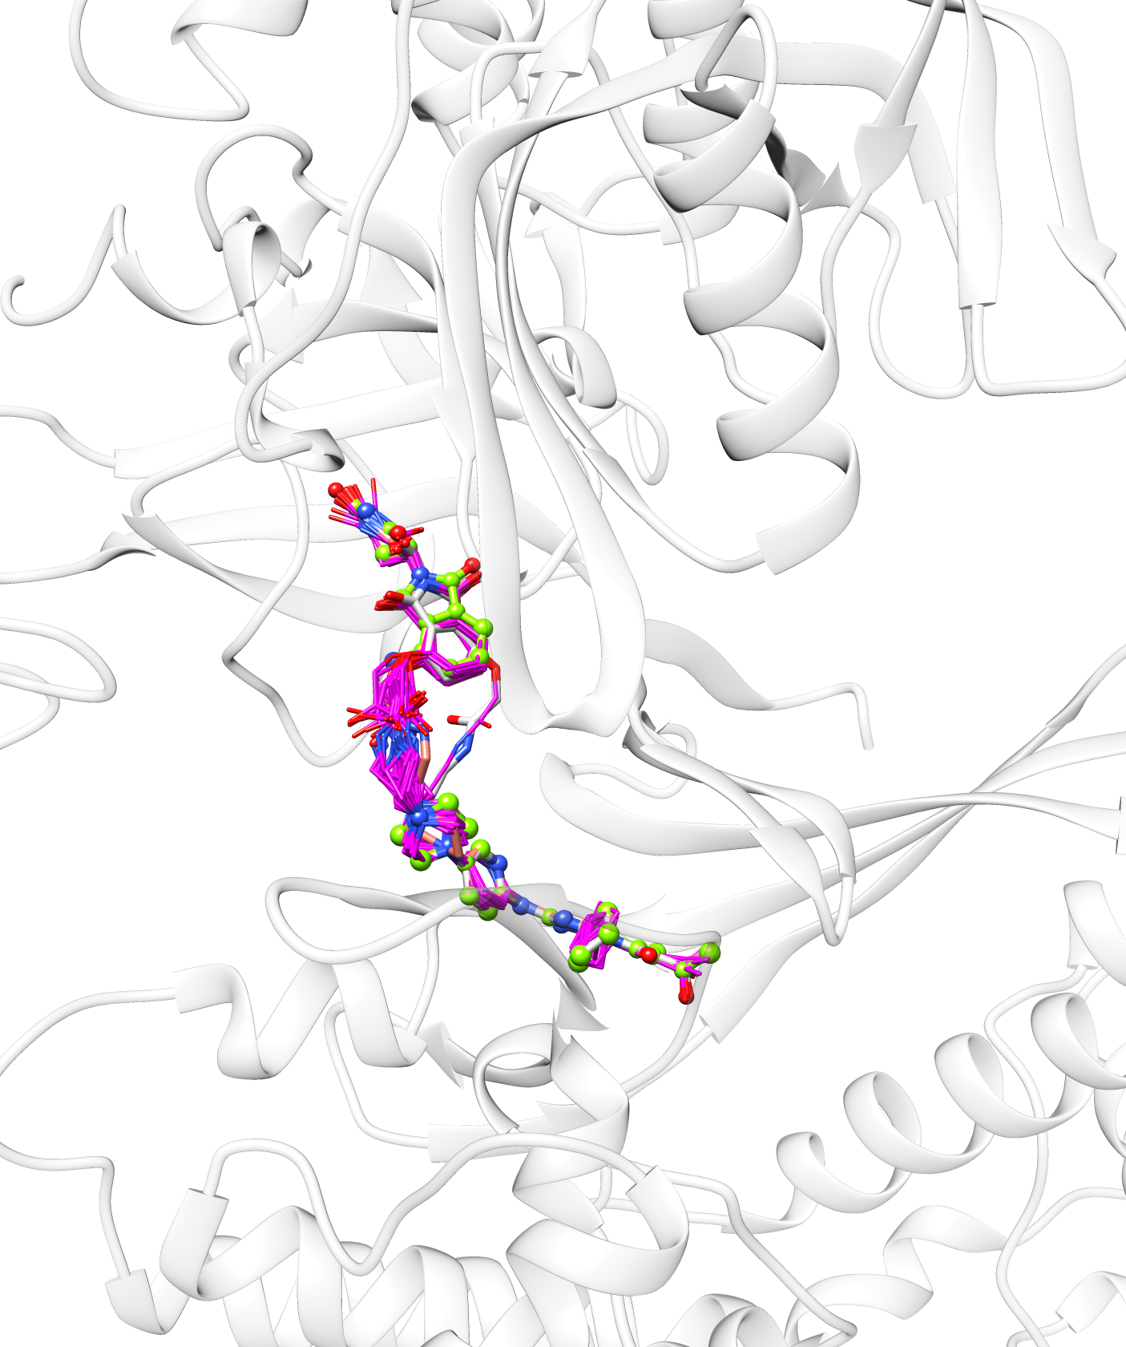
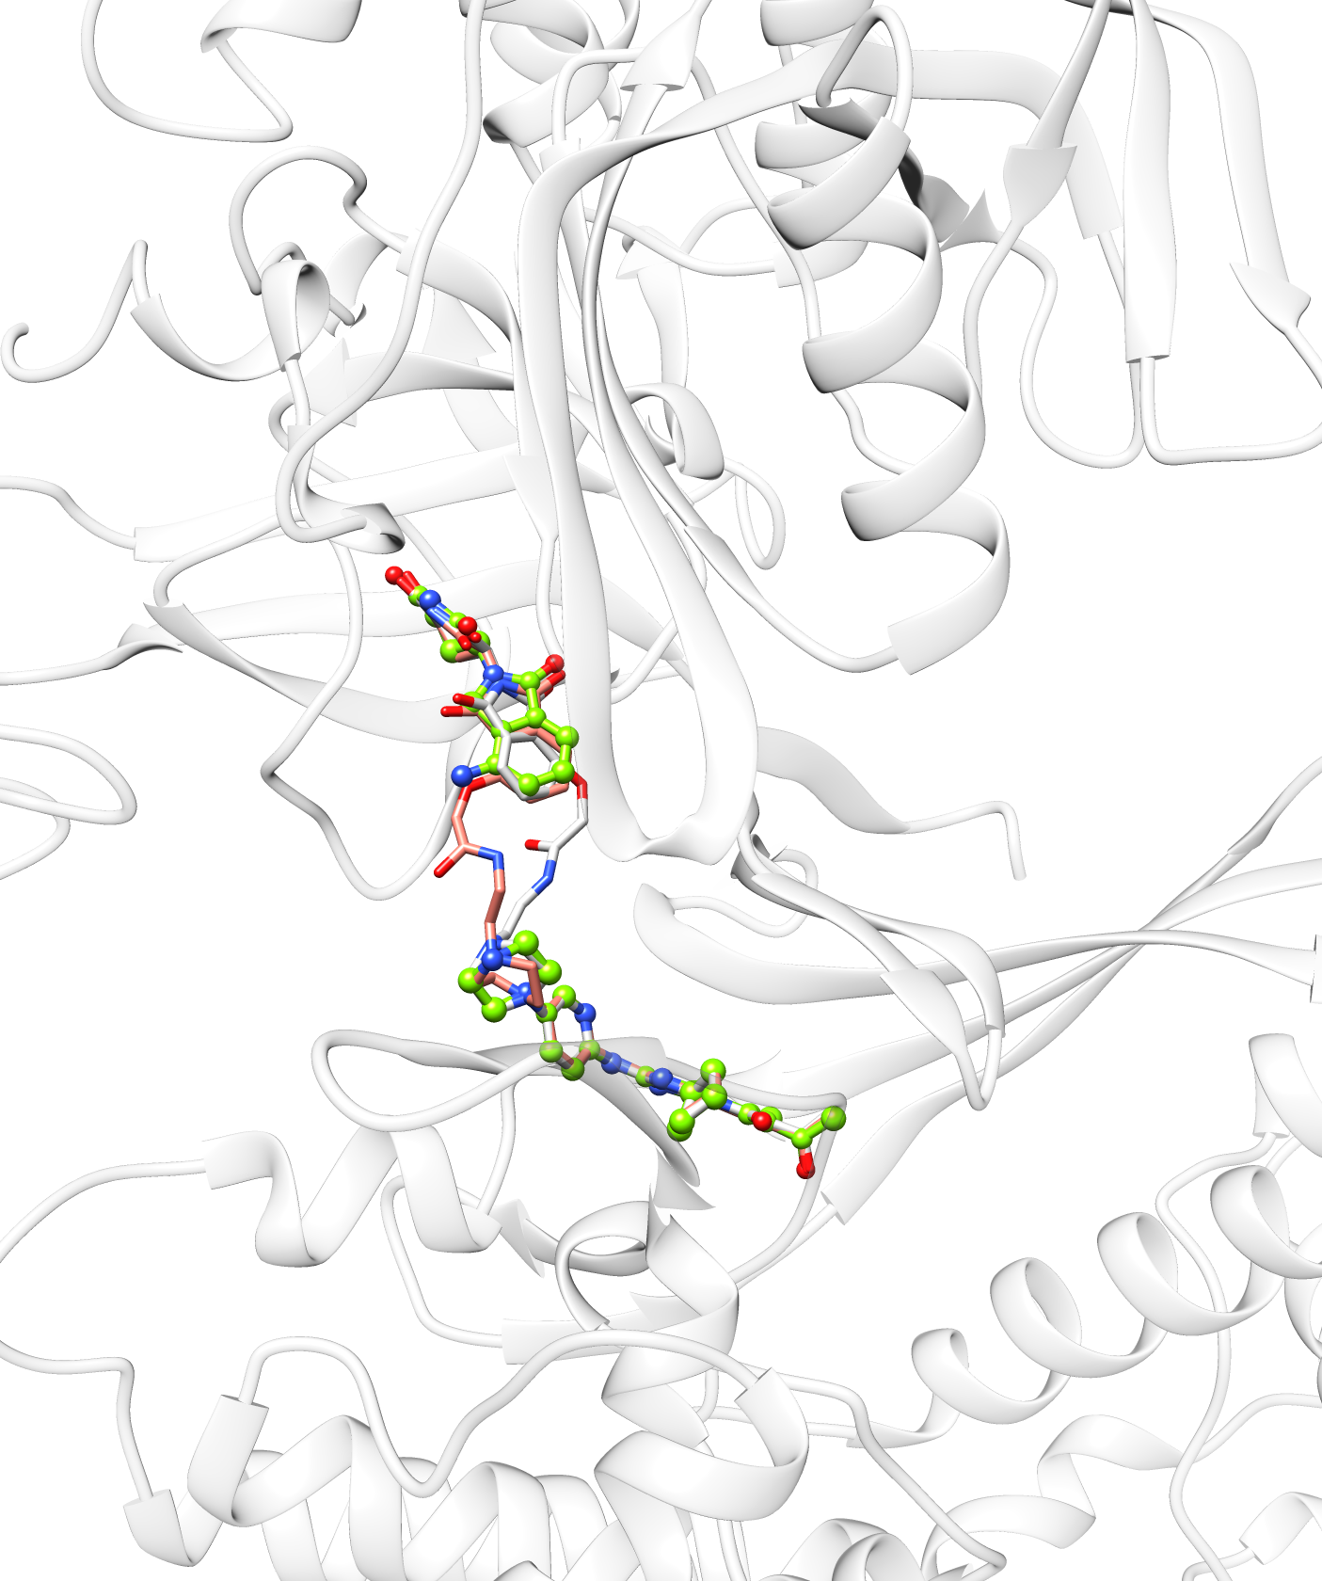

Slide 8
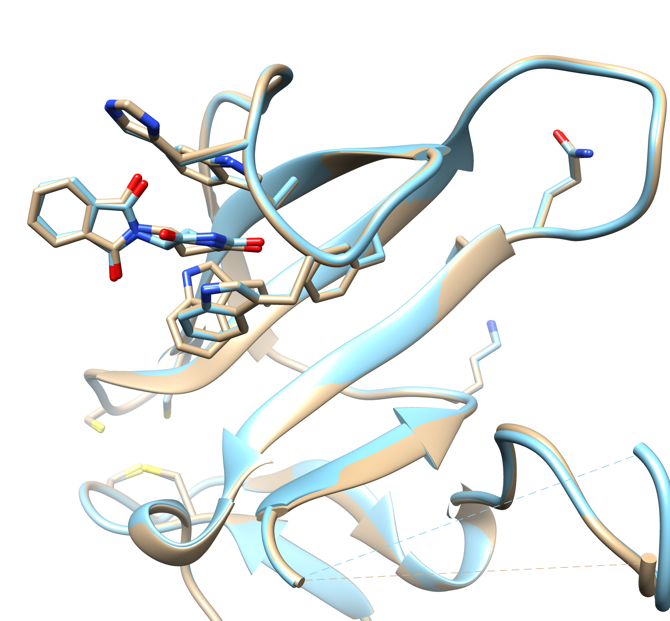
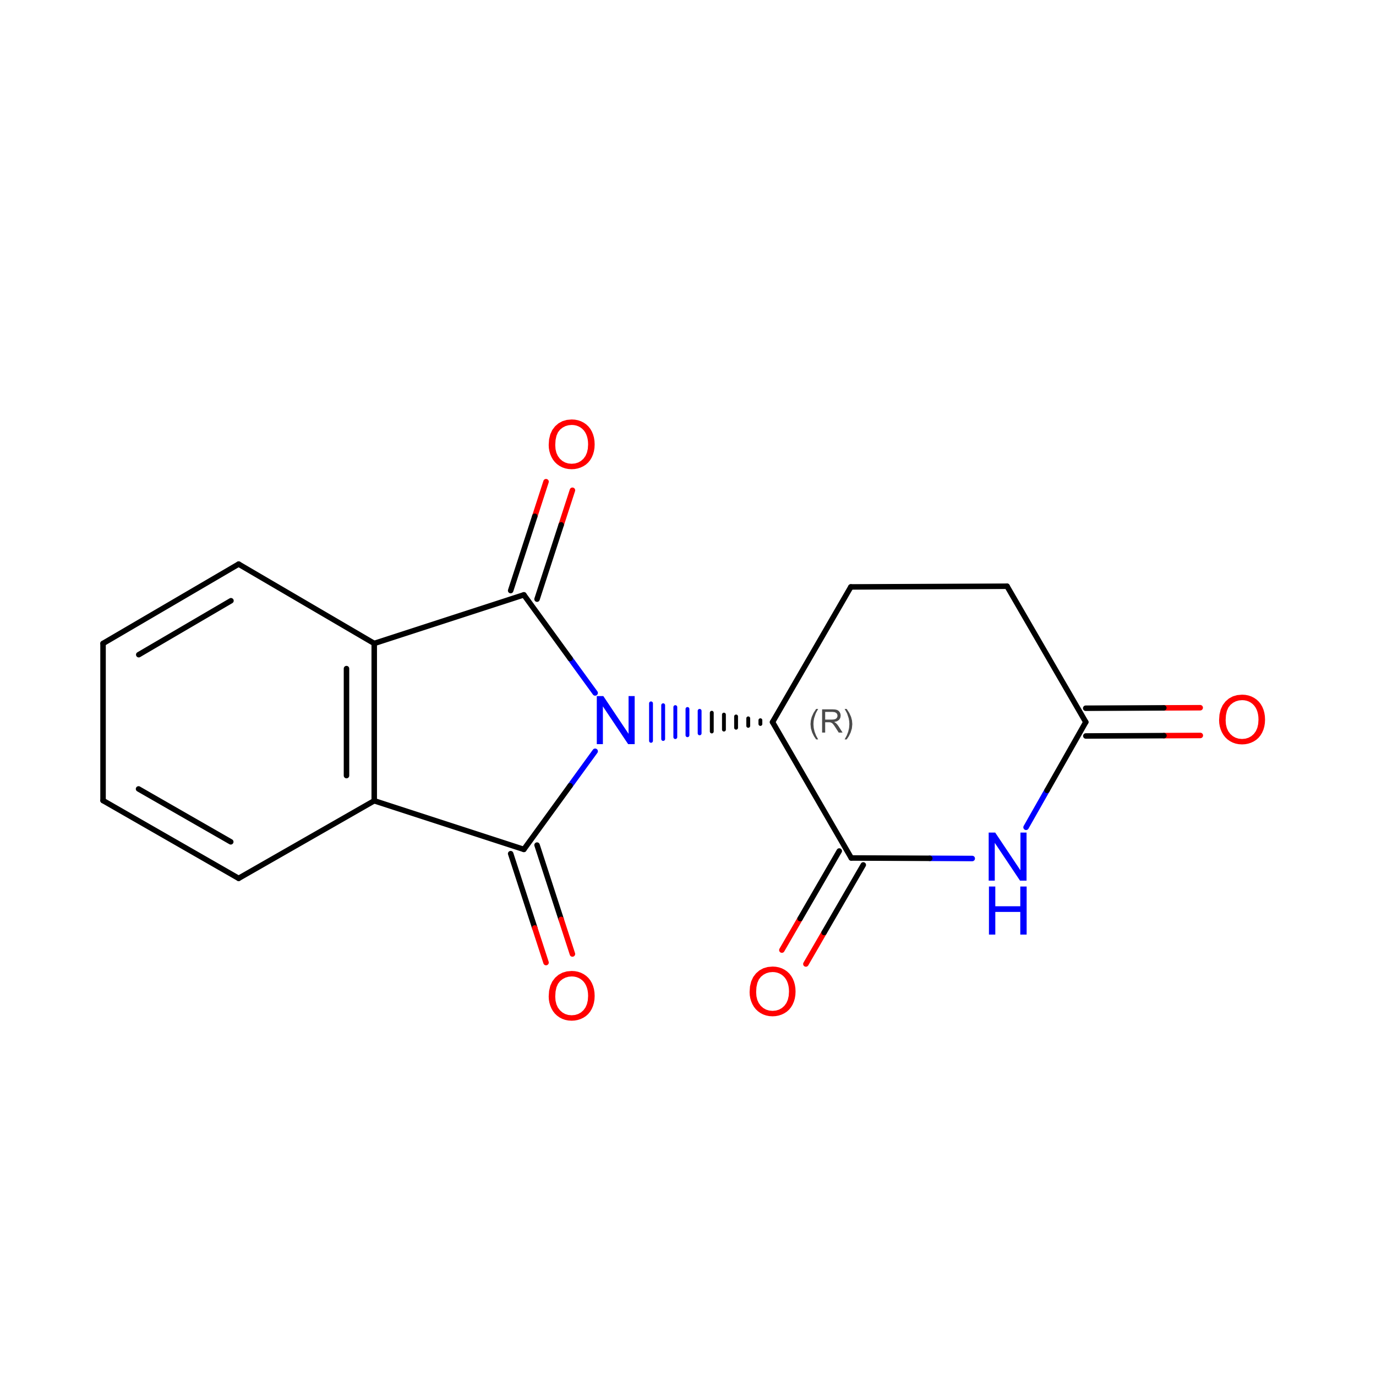
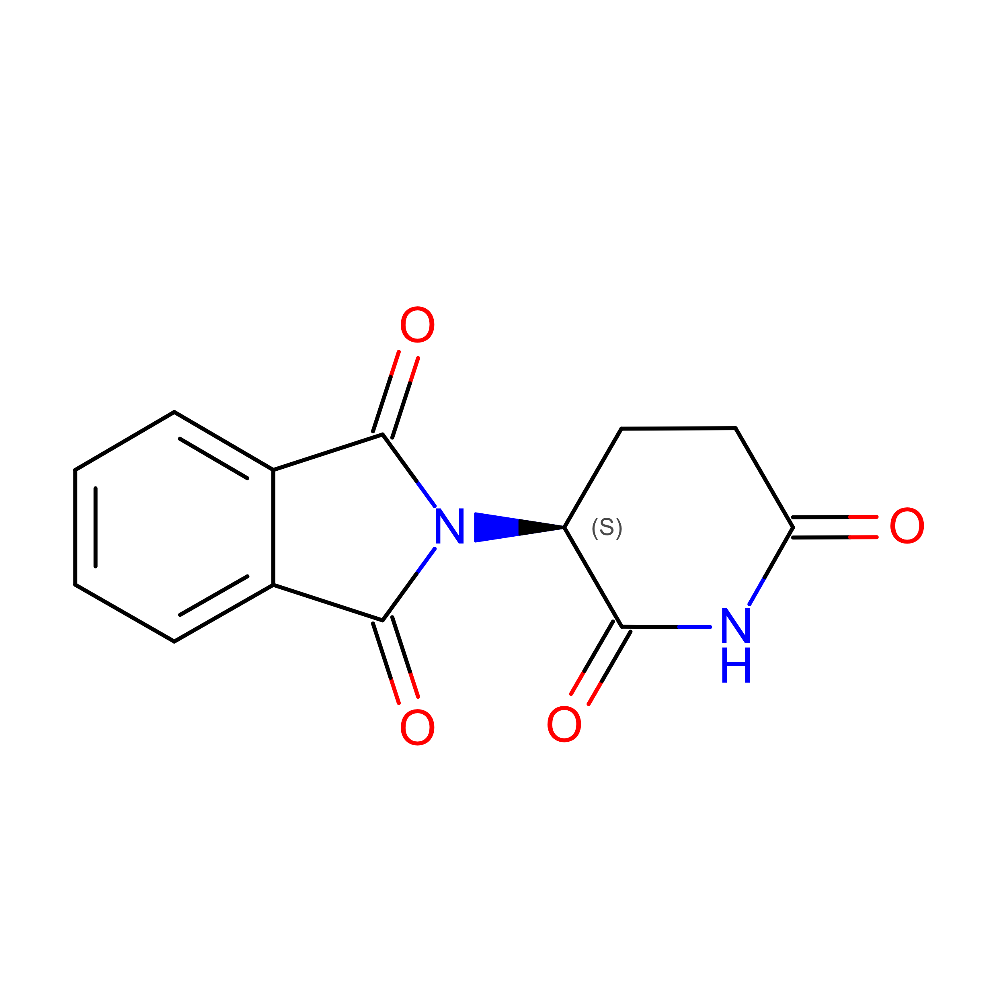
Cereblon bound to thalidomide
PDB ID | resolution | organism | ligand | chemical structure
5YJ1 | 2.00 Å | mouse | R-thalidomide
5YJ0 | 1.80 Å | mouse | S-thalidomide
5YJ1
5YJ0
thalidomide
Since PROTACs are flexible, maybe it’s the direct interaction between CDK6 and cereblon that matters more?

